Slide 1
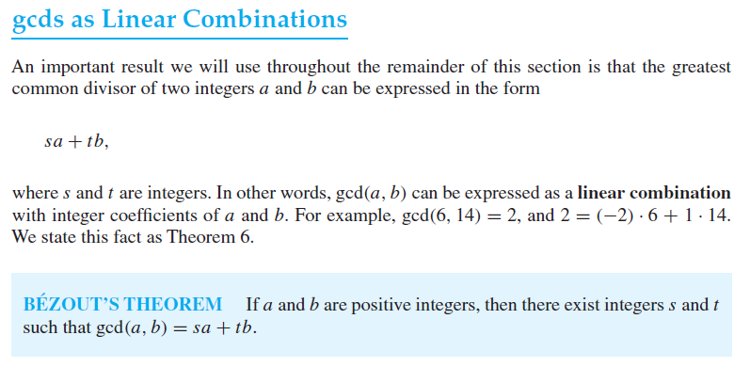
Notes:
Gcd as linear combination aAlso called extended eucledian algorithm
gcd(a,b) = sa+tb, is ka matlab hay k hm gcd ko multipliers of a and b ki form mein bhi likh saktay hein

Slide 2
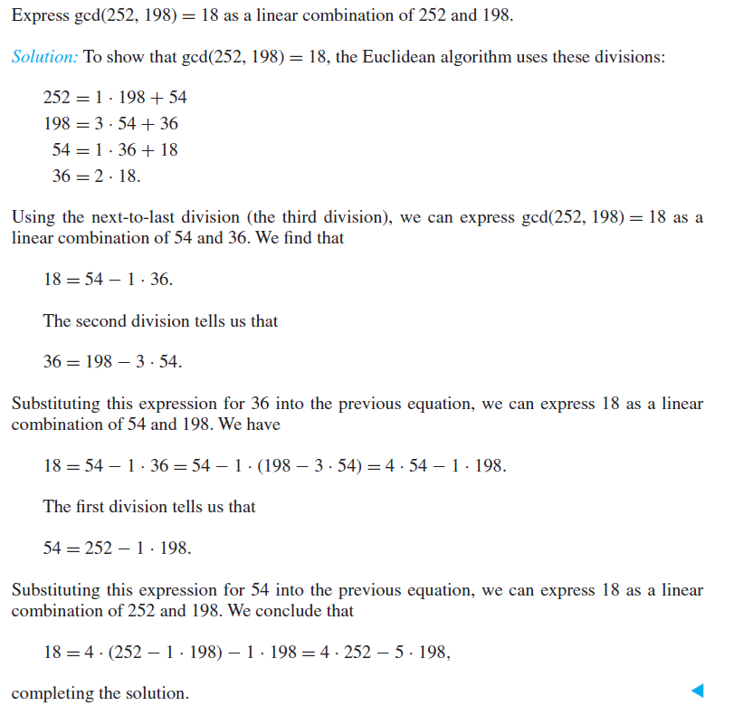
Notes:
More examples :
==========
gcd(1701,3768)
gcd(888,54)
gcd(1180,482)

Slide 3
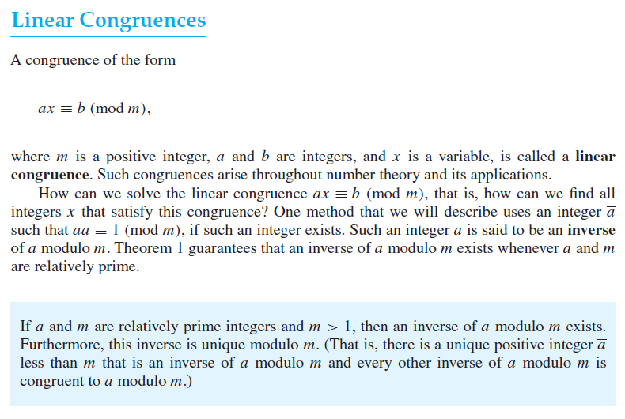

Slide 4
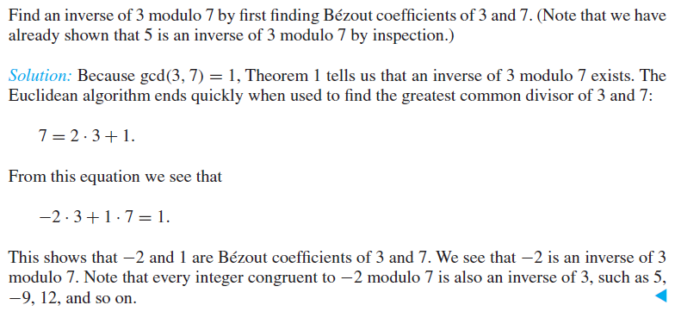
Notes:
This is the method of finding inverse of n mod m using ecucledian algorithm
-2+7=5 -2+(-7)=-9
5+7=12 -9+(-7)=-16
12+7=19 -16+(-7)=-23
19+7=26, etc -23+(-7)=-30,etc
So 5, 12,19,26,-9,-16-23,-30, etc are also inverse of 3 modulus 7, because these integers are congruent to -2 mod 7 i.e. x = -2 mod 7

Slide 5
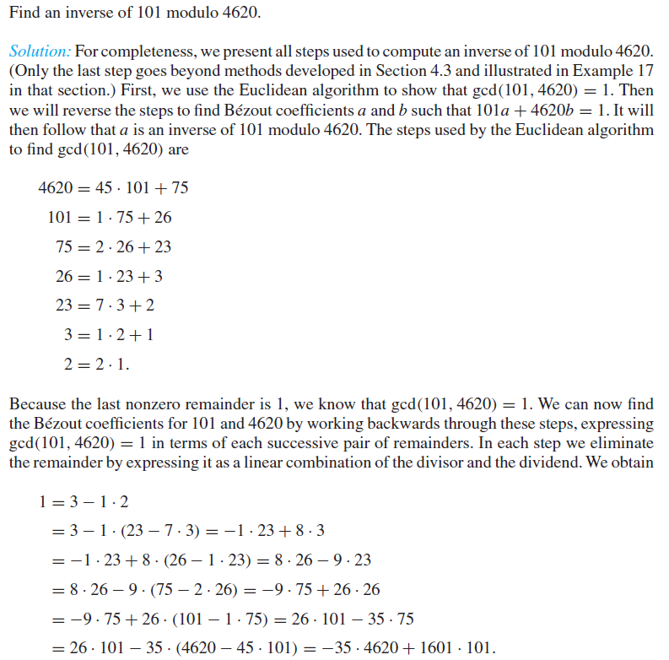
Notes:
More examples :
==========
Inverse of 27 mod 392

Slide 6
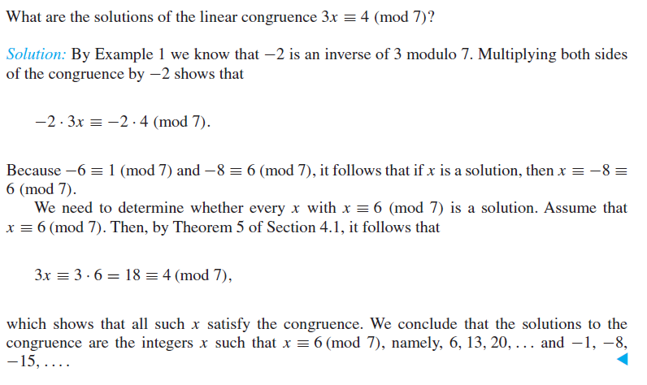
Notes:
Solving linear congruence :
================
https://www.youtube.com/watch?v=HklhuO79U3s
so x=6
6+7=13
13+7=20, etc are also inverse of 3 mod 7 because x = 6 mod 7, where x = 6,13,20, etc

Slide 7
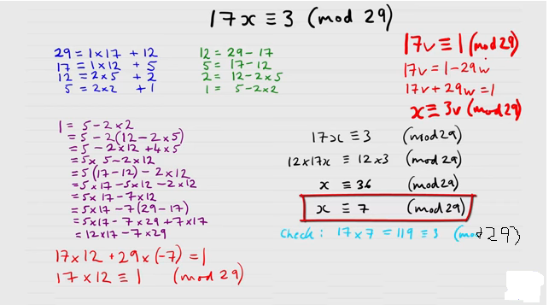
Notes:
So x = 7,
7+29=36
36+29=65. etc are also inverse of 17 mod 29 because x = 7 mod 29, where x = 36,65, etc

Slide 8
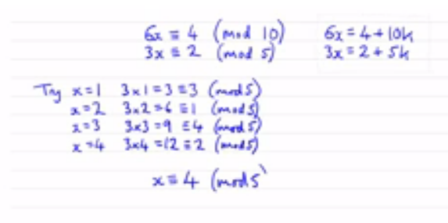

Slide 9

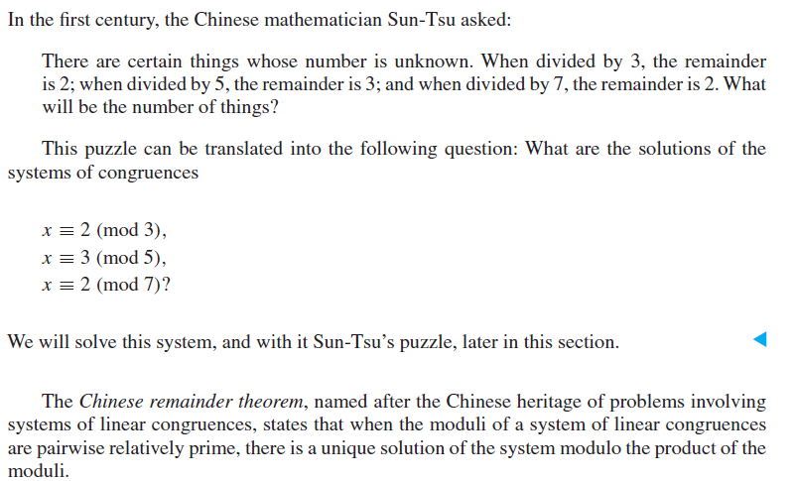
Notes:
Chinese remainder theorem:
==================
https://www.youtube.com/watch?v=Y5RcMWiUyyE

Slide 10
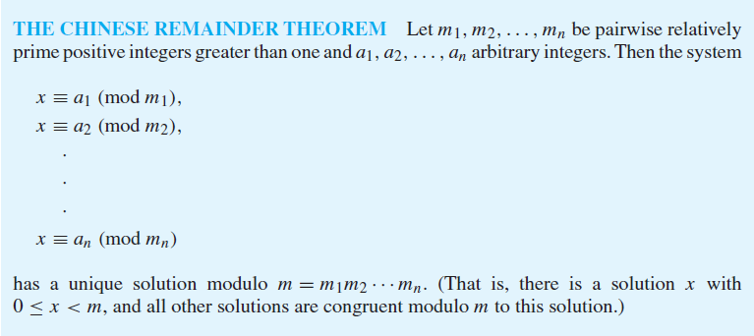
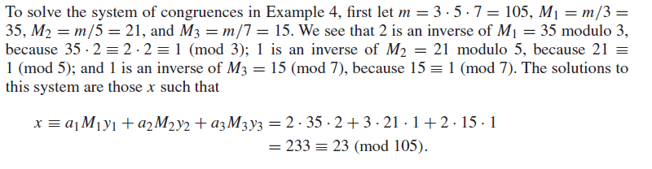

Slide 11
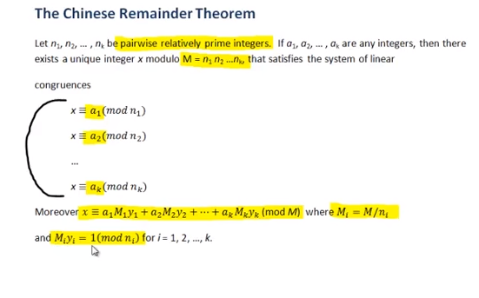

Slide 12
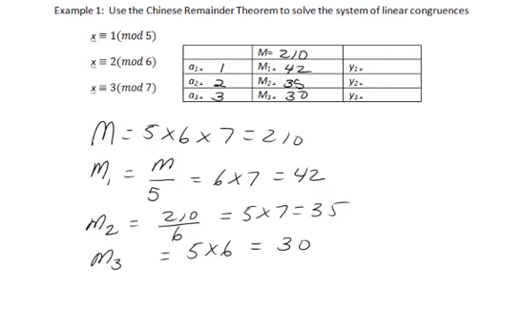

Slide 13
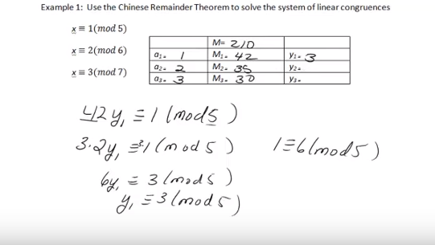
Notes:
y1 k saath jo value hoti hay wo hamesha mod say choti honi chaheyye inverse nikalnay k liye

Slide 14
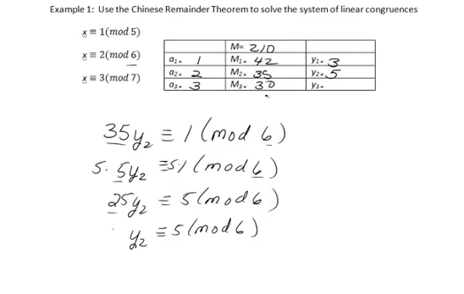

Slide 15
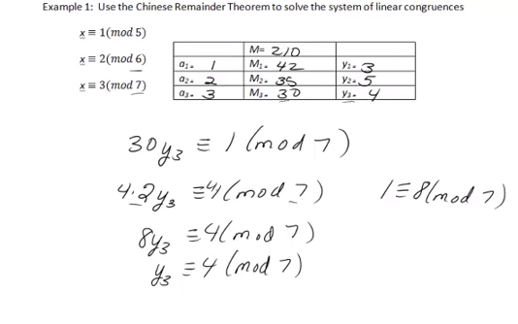

Slide 16
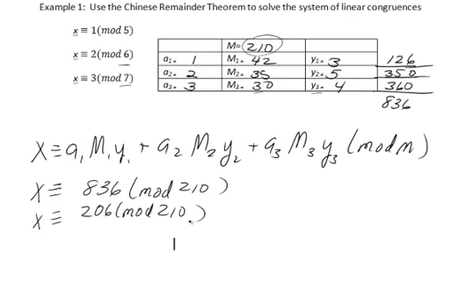

Slide 17
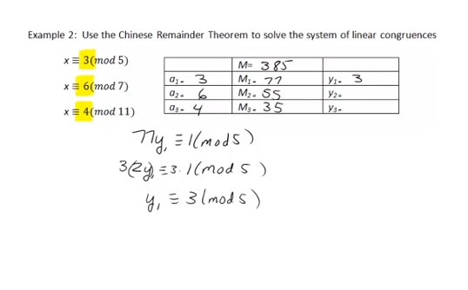

Slide 18
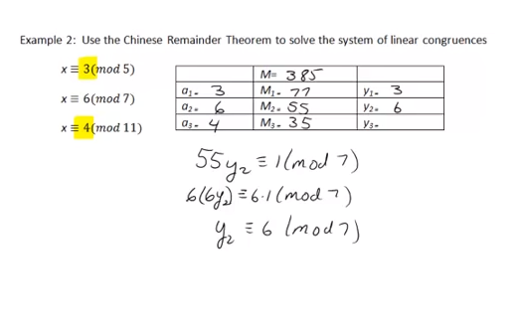

Slide 19
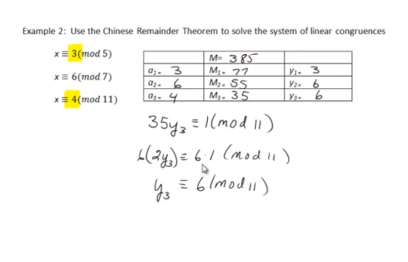

Slide 20
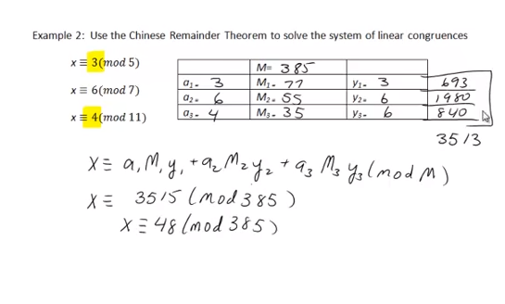

Slide 21
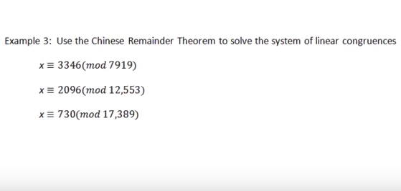

Slide 22
Notes:
Example of chinese remainder theorem

Slide 23
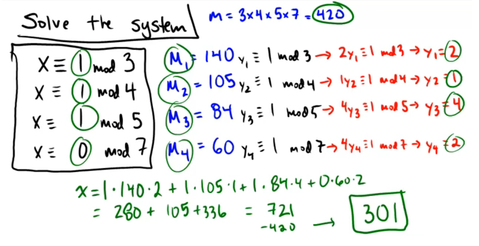
Notes:
Example of chinese remainder theorem

Slide 24
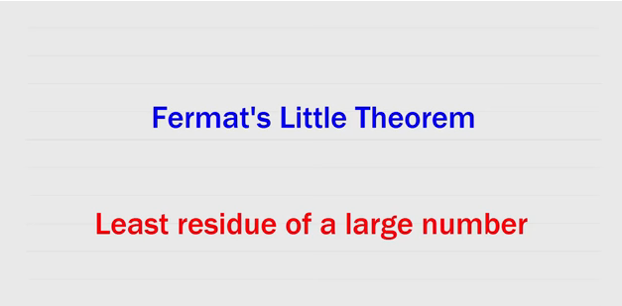
Notes:
Fermat’s little theorem:
============== https://www.youtube.com/watch?v=pMA-dD-KCWM

Slide 25
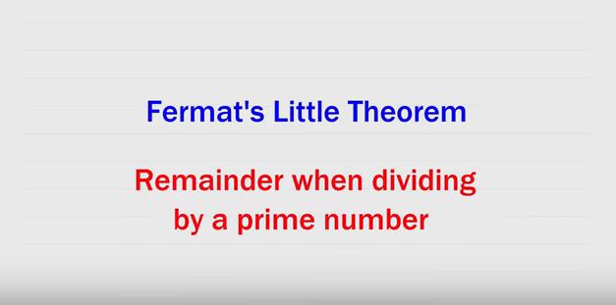

Slide 26
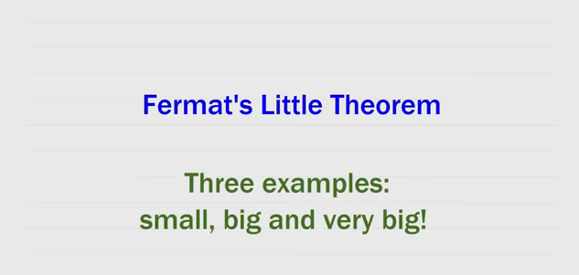

Slide 27
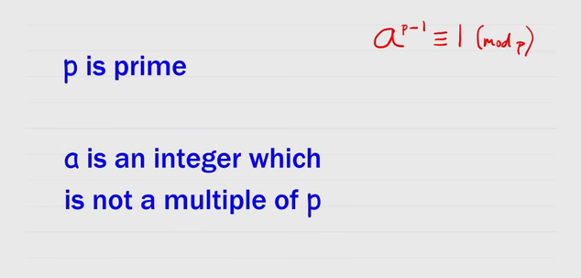

Slide 28
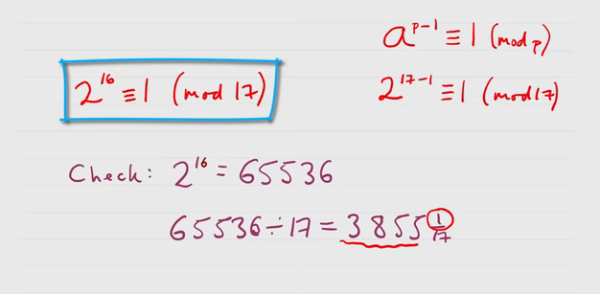

Slide 29
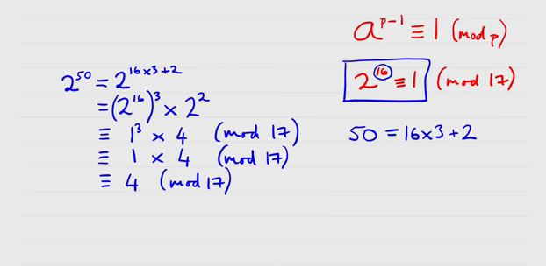

Slide 30
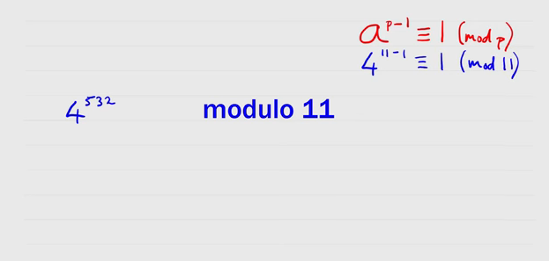

Slide 31
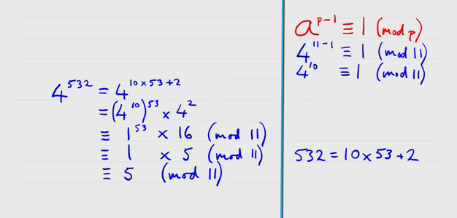
Notes:
To find remainder of larger number :
=====================
https://www.youtube.com/watch?v=cI4rLl02_tw
More examples :
39 raise to the power 22 divide by 7
3 raise to the power 239 divide by 16
2 raise to the power 1003 divide by 25
4 raise to the power 96 divide by 6

